Slide 1
VLAN concept, Configuration, Trunks, Trunking Protocol
Lecture: 23
Prepared by: Dr. Gagan Singla
Department of Computer Science and Engineering,
Chitkara University, Punjab
Computer Networks _22CS008

Slide 2
What will I learn to do in this module?
Overview of VLANs
VLAN Configuration
﻿VLAN Trunks
Dynamic Trunking Protocol

Slide 3
VLAN Definitions
Virtual LANs (VLANs) provide segmentation and organizational flexibility in a switched network.
A group of devices within a VLAN communicate as if each device was attached to the same cable.
VLANs are based on logical connections, instead of physical connections.
As shown in the figure 1, VLANs in a switched network enable users in various departments (i.e., IT, HR, and Sales) to connect to the same network regardless of the physical switch being used or location in a campus LAN.

Slide 4
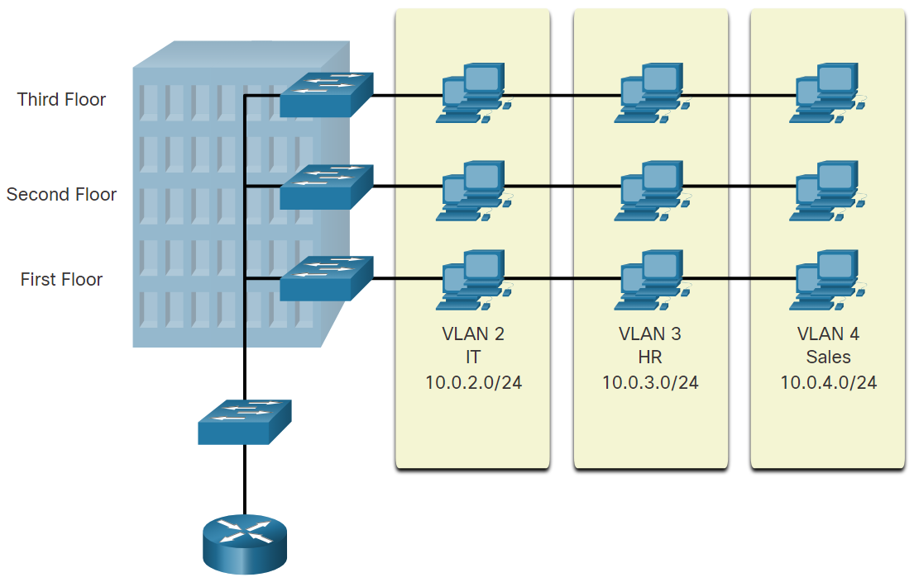
VLANs in a switched network
The figure shows a 3-floor building with a switch on each floor. The switches are connected to another switch which is connected to a router.
Each floor has multiple hosts connected to it. There are three VLANs that span all three floors and contain multiple hosts on each floor. The VLANs are: VLAN 2, IT, 10.0.2.0/24; VLAN 3, HR, 10.0.3.0/24; VLAN 4, Sales, 10.0.4.0/24.
Figure 1 VLANs in a switched network

Slide 5
Benefits of a VLAN Design
Smaller broadcast domains
Improved security
Improved IT efficiency
Reduced cost
Better performance
Simpler project and application management

Slide 6
Types of VLANs
Default VLAN: The default VLAN on a Cisco switch is VLAN 1. Therefore, all switch ports are on VLAN 1 unless it is explicitly configured to be on another VLAN.
Data VLAN: Data VLANs are VLANs configured to separate user-generated traffic. They are referred to as user VLANs because they separate the network into groups of users or devices.
Native VLAN: User traffic from a VLAN must be tagged with its VLAN ID when it is sent to another switch. Trunk ports are used between switches to support the transmission of tagged traffic.
A switch may also have to send untagged traffic across a trunk link. Untagged traffic is generated by a switch and may also come from legacy devices. The 802.1Q trunk port places untagged traffic on the native VLAN. The native VLAN on a Cisco switch is VLAN 1 (i.e., default VLAN).

Slide 7
Types of VLANs
Management VLAN: A management VLAN is a data VLAN configured specifically for network management traffic including SSH, Telnet, HTTPS, HTTP, and SNMP. By default, VLAN 1 is configured as the management VLAN on a Layer 2 switch.
Voice VLAN: A separate VLAN is needed to support Voice over IP (VoIP). VoIP traffic requires the following:
Assured bandwidth to ensure voice quality
Transmission priority over other types of network traffic
Ability to be routed around congested areas on the network
Delay of less than 150 ms across the network
To meet these requirements, the entire network has to be designed to support VoIP.

Slide 8
Defining VLAN Trunks
VLANs would not be very useful without VLAN trunks. VLAN trunks allow all VLAN traffic to propagate between switches. This enables devices connected to different switches but in the same VLAN to communicate without going through a router.
A trunk is a point-to-point link between two network devices that carries more than one VLAN. A VLAN trunk extends VLANs across an entire network.
A VLAN trunk does not belong to a specific VLAN. Instead, it is a conduit for multiple VLANs between switches and routers. A trunk could also be used between a network device and server or another device that is equipped with an appropriate 802.1Q-capable NIC. By default, on a Cisco Catalyst switch, all VLANs are supported on a trunk port.

Slide 9
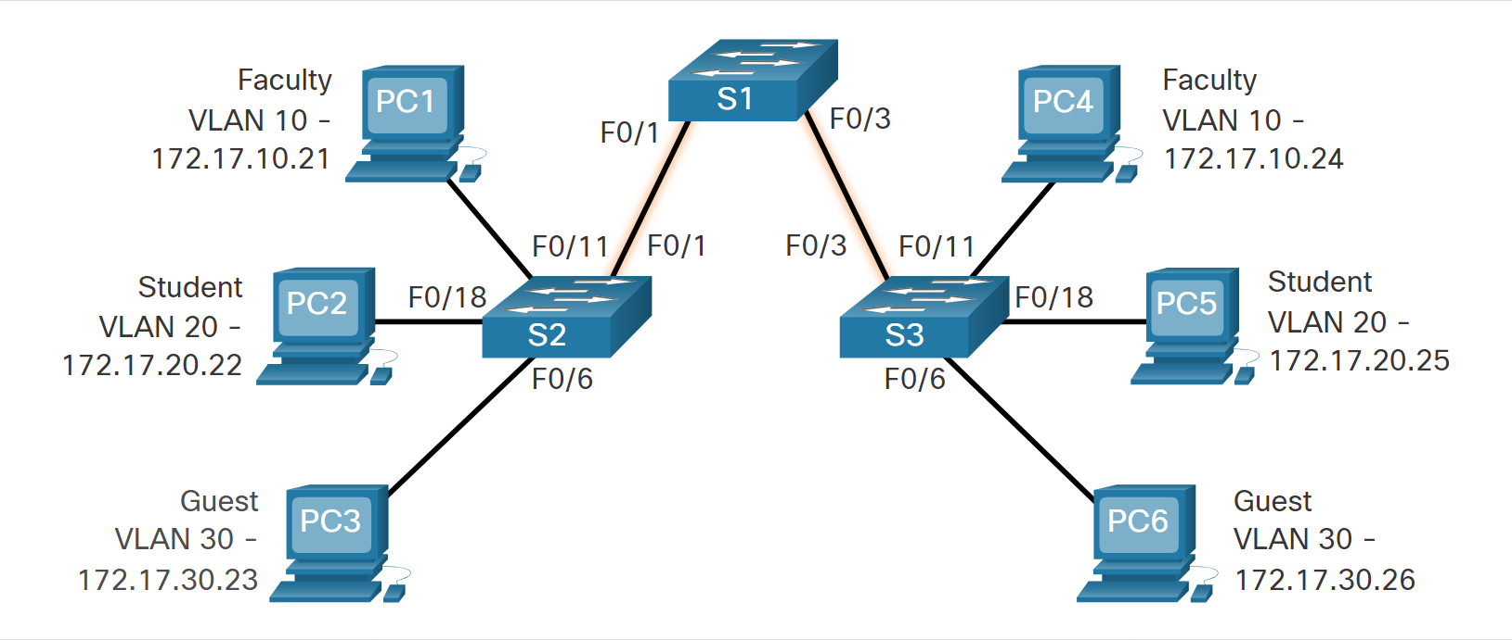
VLAN configuration
In the figure, the highlighted links between switches S1 and S2, and S1 and S3 are configured to transmit traffic coming from VLANs 10, 20, 30 (i.e., native VLAN) across the network.
Figure 2 VLAN configuration

Slide 10
VLAN Creation Commands
Task | IOS Command
Enter global configuration mode. | Switch# configure terminal
Create a VLAN with a valid ID number. | Switch(config)# vlan vlan-id
Specify a unique name to identify the VLAN. | Switch(config-vlan)# name vlan-name
Return to the privileged EXEC mode. | Switch(config-vlan)# end

Slide 11
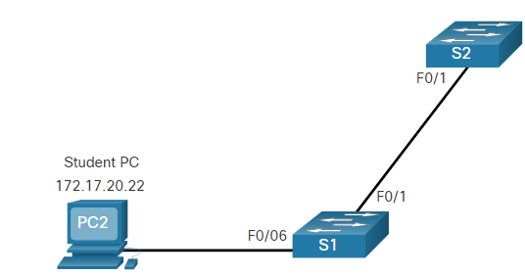
VLAN Creation Example
In the topology, the student computer (PC2) has not been associated with a VLAN yet, but it does have an IP address of 172.17.20.22, which belongs to VLAN 20.
S1# configure terminal
S1(config)# vlan 20
S1(config-vlan)# name student
S1(config-vlan)# end
Figure 3 VLAN Creation Example
The example shows how the student VLAN (VLAN 20) is configured on switch S1.

Slide 12
Verify VLAN Information
After a VLAN is configured, VLAN configurations can be validated using Cisco IOS show commands.
The show vlan command displays a list of all configured VLANs. The show vlan command can also be used with options. The complete syntax is show vlan [brief | id vlan-id | name vlan-name | summary].
Task | Command Option
Display VLAN name, status, and its ports one VLAN per line. | brief
Display information about the identified VLAN ID number. For vlan-id, the range is 1 to 4094. | id vlan-id
Display information about the identified VLAN name. The vlan-name is an ASCII string from 1 to 32 characters. | name vlan-name
Display VLAN summary information. | summary

Slide 13
Verify VLAN Information
The show vlan summary command displays the count of all configured VLANs.
S1# show vlan summary
Number of existing VLANs : 7
Number of existing VTP VLANs : 7
Number of existing extended VLANS : 0
Other useful commands are the
show interfaces interface-id
switchport
show interfaces vlan vlan-id
For example, the show interfaces fa0/18 switchport command can be used to confirm that the FastEthernet 0/18 port has been correctly assigned to data and voice VLANs.

Slide 14
Trunk Configuration Commands
Task | IOS Command
Enter global configuration mode. | Switch# configure terminal
Enter interface configuration mode. | Switch(config)# interface interface-id
Set the port to permanent trunking mode. | Switch(config-if)# switchport mode trunk
Sets the native VLAN to something other than VLAN 1. | Switch(config-if)# switchport trunk native vlan vlan-id
Specify the list of VLANs to be allowed on the trunk link. | Switch(config-if)# switchport trunk allowed vlan vlan-list
Return to the privileged EXEC mode. | Switch(config-if)# end

Slide 15
Dynamic Trunking Protocol
Some Cisco switches have a proprietary protocol that lets them automatically negotiate trunking with a neighboring device. This protocol is called Dynamic Trunking Protocol (DTP).
DTP can speed up the configuration process for a network administrator.
An interface can be set to trunking or nontrunking, or to negotiate trunking with the neighbor interface. Trunk negotiation is managed by DTP.
DTP is a Cisco proprietary protocol that is automatically enabled.
DTP manages trunk negotiation only if the port on the neighbor switch is configured in a trunk mode that supports DTP. Switches from other vendors do not support DTP.

Slide 16
Dynamic Trunking Protocol
To enable trunking from a Cisco switch to a device that does not support DTP, use the following configuration mode commands.
S1(config-if)# switchport mode trunk
S1(config-if)# switchport nonegotiate
This causes the interface to become a trunk, but it will not generate DTP frames.
To re-enable dynamic trunking protocol use the switchport mode dynamic auto command.
S1(config-if)# switchport mode dynamic auto

Slide 17
Negotiated Interface Modes
The switchport mode command has additional options for negotiating the interface mode. The full command syntax is the following:
Option | Description
access | Puts the interface (access port) into permanent nontrunking mode and negotiates to convert the link into a nontrunk link. The interface becomes a nontrunk interface, regardless of whether the neighboring interface is a trunk interface.
dynamic auto | Makes the interface able to convert the link to a trunk link. The interface becomes a trunk interface if the neighboring interface is set to trunk or desirable mode. The default switchport mode for all Ethernet interfaces is dynamic auto.
dynamic desirable | Makes the interface actively attempt to convert the link to a trunk link. The interface becomes a trunk interface if the neighboring interface is set to trunk, desirable, or dynamic auto mode.
trunk | Puts the interface into permanent trunking mode and negotiates to convert the neighboring link into a trunk link. The interface becomes a trunk interface even if the neighboring interface is not a trunk interface.

Slide 18
Results of a DTP Configuration
The table illustrates the results of the DTP configuration options on opposite ends of a trunk link connected to Catalyst 2960 switch ports.
 | Dynamic Auto | Dynamic Desirable | Trunk | Access
Dynamic Auto | Access | Trunk | Trunk | Access
Dynamic Desirable | Trunk | Trunk | Trunk | Access
Trunk | Trunk | Trunk | Trunk | Limited connectivity
Access | Access | Access | Limited connectivity | Access

Slide 19
Verify DTP Mode
The default DTP mode is dependent on the Cisco IOS Software version and on the platform. To determine the current DTP mode, issue the show dtp interface command as shown in the output.
S1# show dtp interface fa0/1
DTP information for FastEthernet0/1:
TOS/TAS/TNS: ACCESS/AUTO/ACCESS
TOT/TAT/TNT: NATIVE/NEGOTIATE/NATIVE
Neighbor address 1: C80084AEF101
Neighbor address 2: 000000000000
Hello timer expiration (sec/state): 11/RUNNING
Access timer expiration (sec/state): never/STOPPED
Negotiation timer expiration (sec/state): never/STOPPED
Multidrop timer expiration (sec/state): never/STOPPED
FSM state: S2:ACCESS
# times multi & trunk 0
Enabled: yes
In STP: no

Slide 20
Practice Question 1
What happens to a port that is associated with VLAN 10 when the administrator deletes VLAN 10 from the switch?
The port creates the VLAN again.
The port automatically associates itself with the native VLAN.
The port becomes inactive.
The port goes back to the default VLAN.

Slide 21
Practice Question 2
In which memory location are the VLAN configurations of normal range VLANs stored on a Catalyst switch?
NVRAM
RAM
ROM
flash

Slide 22
Practice Question 3
An administrator is investigating a failure on a trunk link between a Cisco switch and a switch from another vendor. After a few show commands, the administrator notices that the switches are not negotiating a trunk. What is a probable cause for this issue?
DTP frames are flooding the entire network.
Switches from other vendors do not support DTP.
Both switches are in nonegotiate mode.
Both switches are in trunk mode.

Slide 23
Practice Question 4
What are three primary benefits of using VLANs? (Choose three.)
cost reduction
improved IT Staff efficiency
end user satisfaction
security
a reduction in the number of trunk links

Slide 24
Practice Question 5
When a Cisco switch receives untagged frames on a 802.1Q trunk port, which VLAN ID is the traffic switched to by default?
native VLAN ID
data VLAN ID
Management VLAN ID
Unused VLAN ID

